Slide 1
AMU TIME
[Rep Names]
September [date], 2016

Slide 2
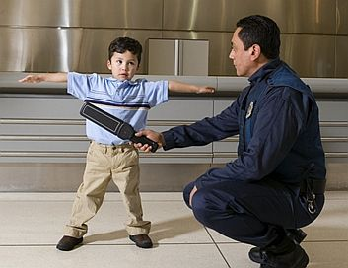
LAUSD Metal Detection Policy Update
We began implementation of this policy on August 22nd, 2016.
In implementing it, GD has limited it to 2 students a day per campus.
Wanding is done before school or during lunch and NOT during instructional time.
Nothing inappropriate has been found as a result of this policy.

Slide 3
LAUSD Metal Detection Policy Update
As a result of our calls to the LAUSD board, Superintendent King and the President of the LAUSD board Steve Zimmer hosted a meeting with our CEO, Cristina De Jesus on August 30th.
King and Zimmer agree that this policy is not what is best for students, but need time to get the entire LAUSD board moving towards an alternative.

Slide 4
LAUSD Metal Detection Policy Update
King and Zimmer have invited GD stakeholders to a follow up meeting to continue hearing our concerns face to face.
GD will be sending 2 parents, an administrator as well as the Presidents of AMU and ACEA.
GD, AMU and ACEA will continue working with the ACLU and other partners to continue the push for a moratorium in this policy.
Go to amuanimo.org to find out more!

Slide 5
AMU Communication Platforms have been Updated
AMU has a new website! Sleek, professional and user friendly! Check it out at: amuanimo.org
AMU is on Instagram! Follow us and participate in our hashtag challenges to win treats for your staff! Follow us at: AMU_ANIMO
AMU is introducing a new format for its MONTHLY Newsletter!

Slide 6
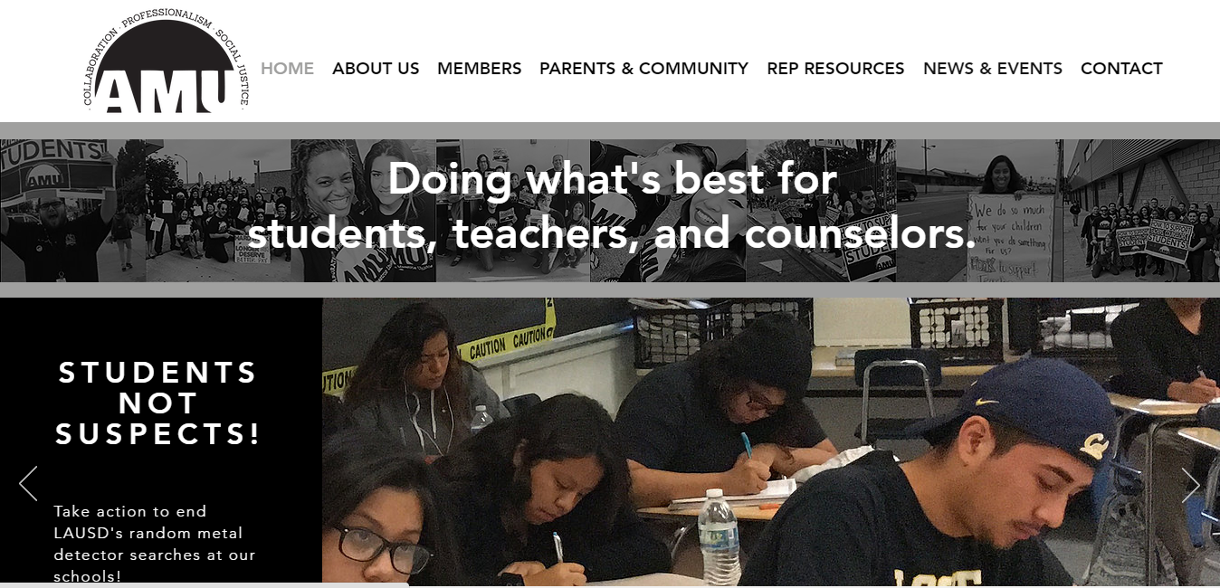

Slide 7
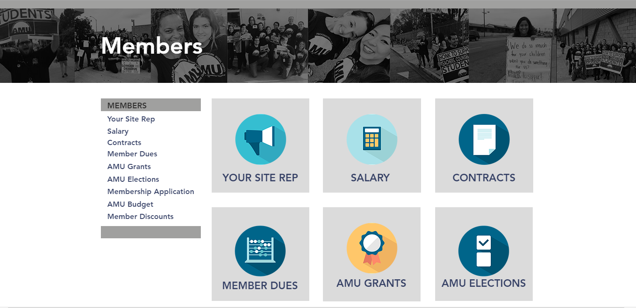
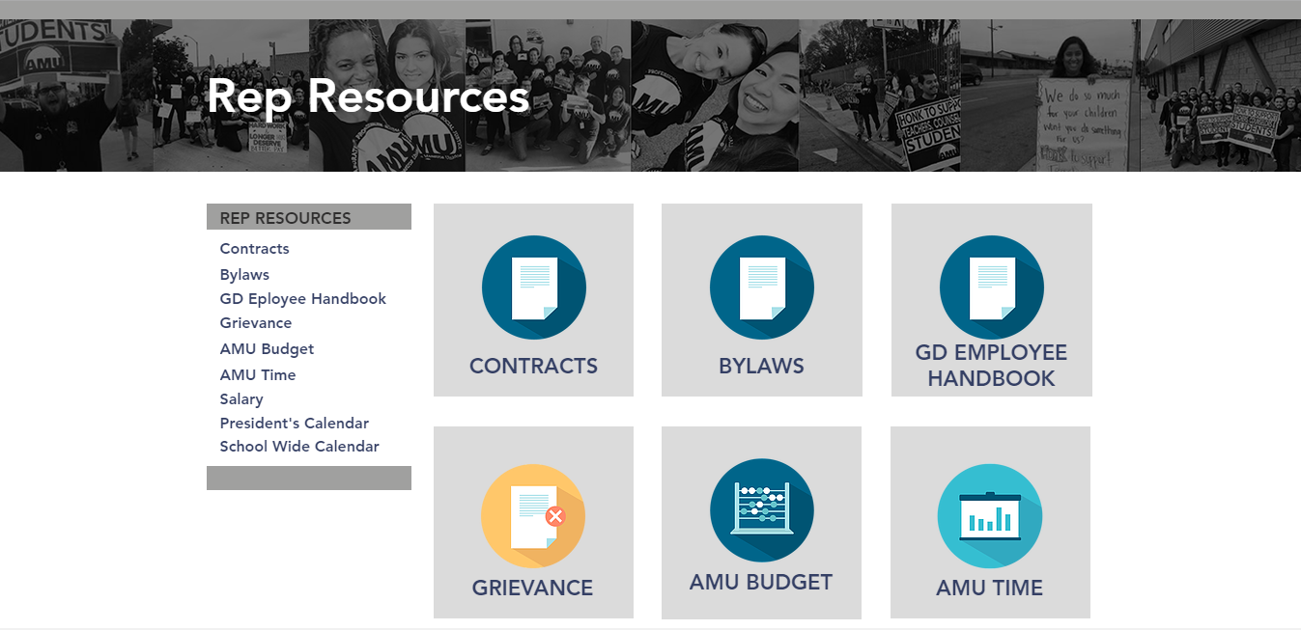

Slide 8
AMU on Instagram
The wining site of the #IamAMU hashtag challenge is Locke Academy Blue for sharing and hashtaging the most pictures in August!
Thanks for sharing your first month back!

Slide 9
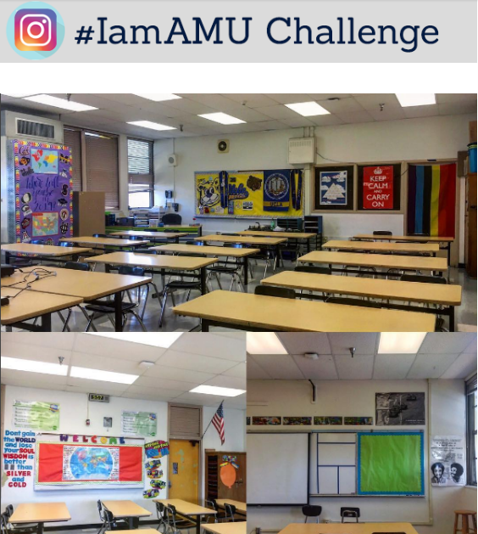
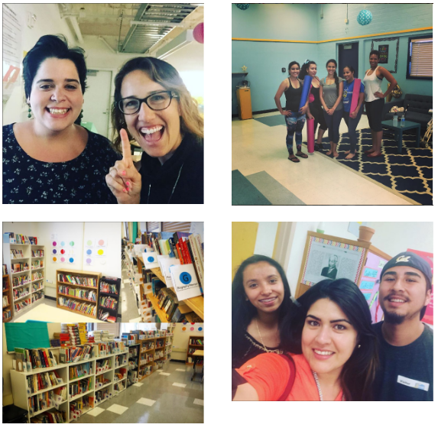
AMU on Instagram

Slide 10
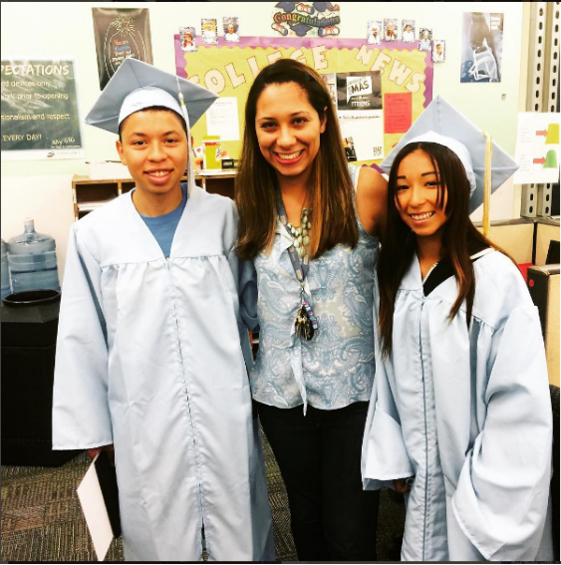
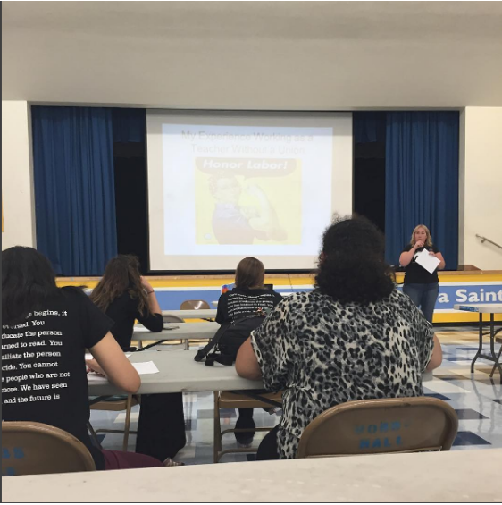
AMU on Instagram

Slide 11
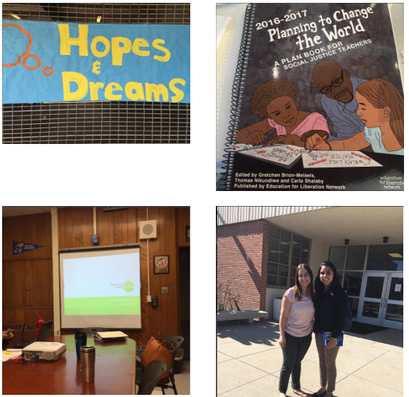
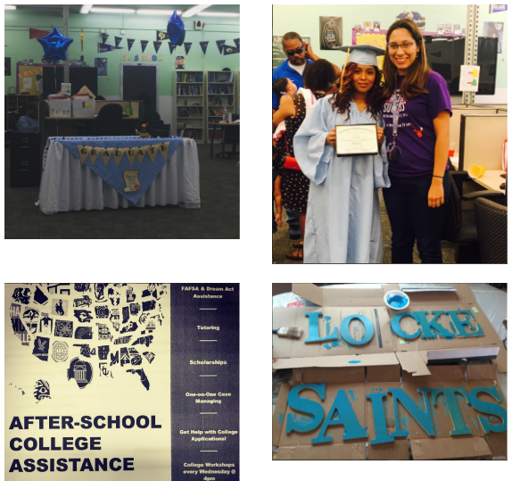
AMU on Instagram

Slide 12
The Advocate AMU’s Monthly Newsletter
AMU’s Newsletter will contain 6 constant sections:
Message from the President
The AMU Did You Know?
Member Spotlight
Student Spotlight
Rep Shout-Out
Updates & Events
Each issue will be site specific (APB edition, AJR edition, etc.)

Slide 13
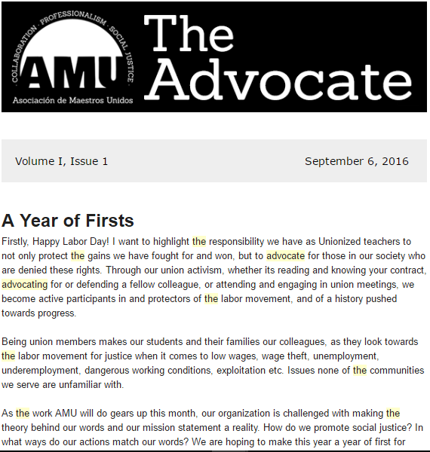
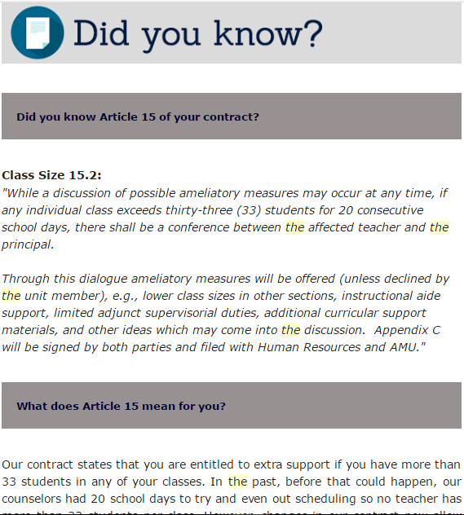
The Advocate AMU’s Monthly Newsletter

Slide 14
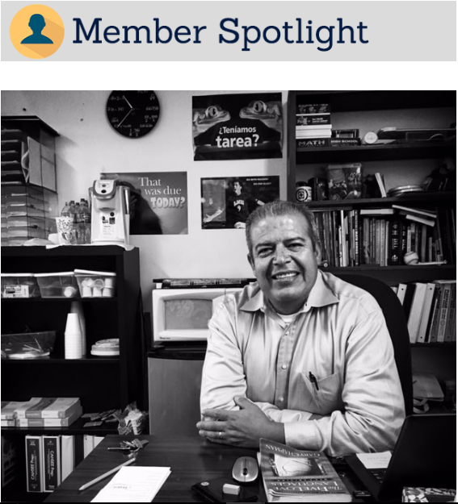
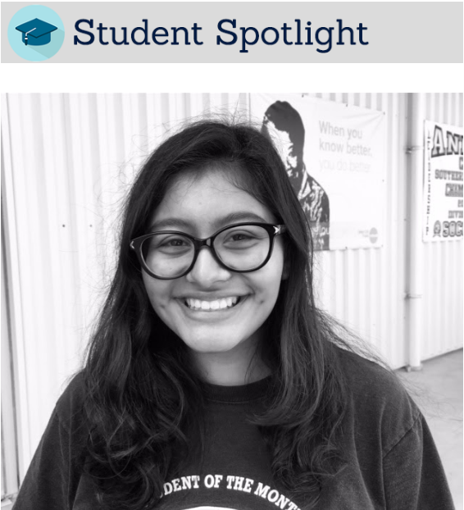
The Advocate AMU’s Monthly Newsletter

Slide 15
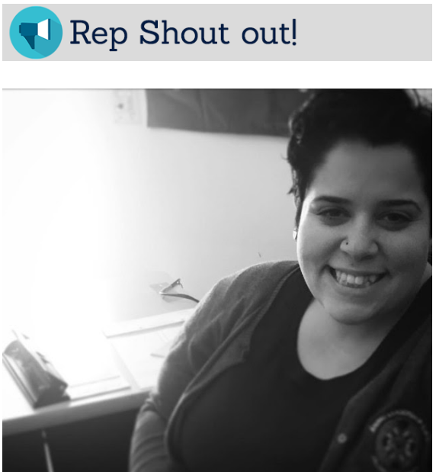
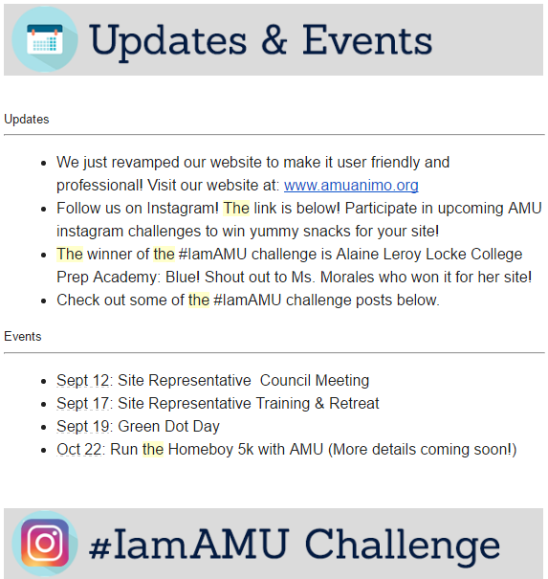
The Advocate AMU’s Monthly Newsletter

Slide 16
The Advocate AMU’s Monthly Newsletter
Send over recommendations for teachers, students and reps to spotlight for coming editions of The Advocate to:
President@amuanimo.org

Slide 17
Run the Homeboy 5k with AMU!
Run (or walk) the Homeboy 5k with AMU on October 22nd, 2016.
Homeboy Industries provides training, and support to formerly gang-involved and previously incarcerated men and women allowing them to redirect their lives and become contributing members of our community.

Slide 18
Run the Homeboy 5k with AMU!
AMU is looking to engage members with activities that ALL members can participate in!
We are also looking to highlight and support events that share our mission of social justice in the communities we serve.
Registration is $50; Register under our team: AMU! All the E-board will be present. Come out and meet other AMU members!

Slide 19
Salary Appeal Victory
A member had been denied an increase in her salary for an entire year, despite her coursework being relevant to her assignment and making her eligible for an increase in salary.
AMU helped her appeal.
Early this year, we won the appeal, and moved her from column IV to column VI.
She will also be receiving retro pay for the year she was denied her rightful increase!

Slide 20
AMU BUDGET APPROVED
A member led Budget Committee has been established and set this years AMU budget.
First time non-union officer members (eboard + reps) are given a direct voice and actionable influence over how union dues are spent.
This years budget was passed by a great majority of our reps.

Slide 21
AMU BUDGET APPROVED
Some highlight of this years budget include:
Eboard (with the expectation of the President) and reps will receive an 8% increase in compensation to, in part, address inflation, but also to recognize the work our union officers do.
The President stipend was decreased until the president can demonstrate she/he deserves extra pay for demonstrably doing extra work. Check out the President’s schedule at: www.amuanimo.org/presidents-calendar
We have closed the counselor VP position (out of compliance with our bylaws), and have allocated that money for 2 scholarships of $1,500 each for GD seniors.

Slide 22
AMU BUDGET APPROVED
President’s communication has been slashed, as AMU WILL NOT be buying the AMU President a phone or establish a $60+ dollar phone line for him.
Reduced funds for Eboard conferences to increase other line items.
Reduced the amount of mileage eboard is allowed to be reimbursed for.
Look it over yourself on our website at:
www.amuanimo.org/amu-budget-1

Slide 23
VOTE YES ON PROP 55

Slide 24
VOTE YES ON PROP 55
AMU and its Site Rep Council voted unanimously to support the passage of Proposition 55.
Why?
Its an extension of prop 30, which we also supported.
Maintains tax increases meant to fund education and healthcare.
100% of our members will be unaffected as single filers (based on their GD salary only). Joint filers affected only if they make $500,000 or more.

Slide 25
VOTE YES ON PROP 55
89% of funds allocated to public schools.
Money NOT for administrative costs; spending administered locally.
Prevents billions in cuts for public education.
Read more on our website at:
www.amuanimo.org/yes-on-prop-55

Slide 26
Build Better LA Initiative
AMU and its Site Rep Council voted unanimously to support the passage of the Build Better LA Initiative which seeks to make living in LA affordable while also pushing for better jobs in LA.
How?
New LA development that include 10+ units would have to allocate a certain percentage of those units as affordable to low-income housing.

Slide 27
Build Better LA Initiative
Developers will be required to:
Be licensed according to city & state law.
Offer 30% of work-hours to city residents, 10% coming from within a 5 mile radius of the building project.
Pay standard wages for the area.
Bars changes to local plans that would “reduce the capacity for creation and preservation of affordable housing and access to local jobs.”

Slide 28
Build Better LA Initiative
In some cases, this initiative can require up to 20% of units in new development projects affordable for low-income or working renters.
This initiative would also, through incentives, encourage these regulations in development projects within half a mile of significant public transit stops.

Slide 29
Build Better LA Initiative
AMU officially supporting this 2016 ballot measure will allow us to work hand in hand with United Parents & Students of Green Dot who also support this measure, and build a coalition with the Los Angeles County Federation of Labor.

Slide 30
Our School & Union Works Because You Do!
[Recognize a member who upholds our union mission of collaboration, professionalism, and social justice]
Make AMU time a place to build and foment member trust, solidarity, and recognition! ☺
[picture?]
[Lesson example?]

Slide 31
Our School & Union Works Because You Do!
This month, we want to recognize a fellow member and colleague for upholding our union mission and values of collaboration, professionalism, and social justice.
Ms. Mac runs a rigorous English class, where there is no compromise when it comes to a students learning, a culturally relevant curriculum, and social justice.
With poems like “Legal Alien” and “Black Rage,” she is CATCHing more than just high benchmark scores! She is valuing, uplifting, and preserving our students’ cultural legacies and lived experiences!
EXAMPLE

