Slide 1
AMU TIME
[Rep Names]
December [date], 2016

Slide 2
Guiding Questions for “AMU TEACHER TALK”
Choose a member to tell their story at your next AMU time.
Give your member at least a week to prepare and provide them a list of questions to choose from.
Member narratives should be about 6 minutes in length.
Member can make a PPT to help them share but it’s not necessary.
Why do you work as a teacher/counselor?
Choose a specific experience you have had in education and relate it to why you continue to stay in teaching/stay in counseling?
What is your vision for the future as a teacher/counselor?
What Barriers have you encountered as a teacher/counselor that prevent you from doing the work the way you believe it should be done?
What gives you hope to continue in education?
*What does being a member of AMU mean to you?
*What are your hopes for AMU in the future
*If your site is not ready for this question that’s fine. However, check in with member who shared latter in the week as ask them these two questions as a follow up
Notes:
As discussed by our Organizing Committee, this can be a powerful component to build solidarity and relationships within AMU time, as well as getting to know our members and their story.
This AMU Time PPT is heavy with updates and Bylaw Business; this is optional for the sake of time.

Slide 3
This Day In Labor History…
Open up AMU time with a “This Day in Labor History” to build Union consciousness and tie our work to the larger arc of social progress pushed by Unions and unionism!
Use this resource:
http://www.unionist.com/today-in-labor-history-95
[picture?]
Notes:
This AMU Time PPT is heavy with updates and Bylaw Business; this is optional for the sake of time.

Slide 4
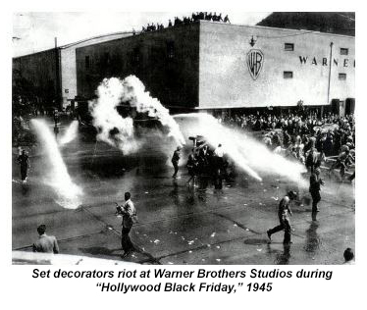
This Day In Labor History…
October 05
A strike by set decorators turns into a bloody riot at the gates of Warner Brothers Studios in Burbank, Calif., when scabs try to cross the picket line. The incident is still identified as "Hollywood Black Friday" and "The Battle of Burbank" - 1945
The UAW ends a 3-week strike against Ford Motor Co. when the company agrees to a contract that includes more vacation days and better retirement and unemployment benefits - 1976
Polish Solidarity union founder Lech Walesa wins the Nobel Peace Prize - 1983
EXAMPLE
Notes:
This AMU Time PPT is heavy with updates and Bylaw Business; this is optional for the sake of time.

Slide 5
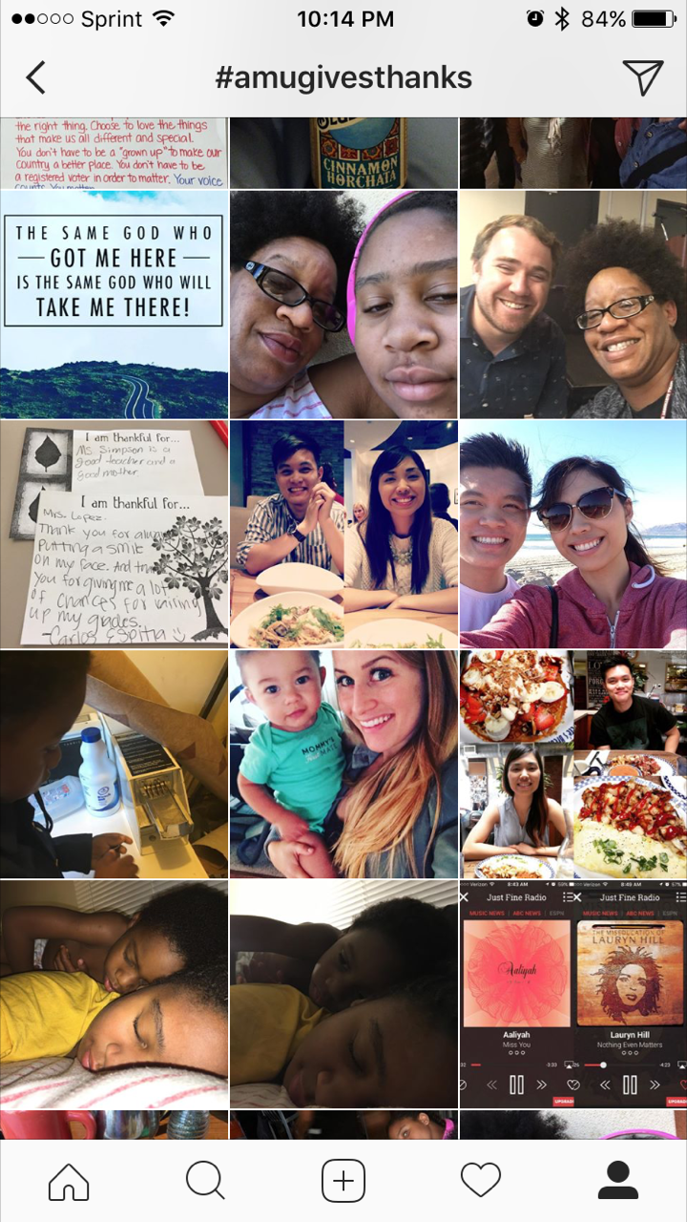
#AMUGivesThanks
AMU is thankful for:
Jenna Lopez
Dawn Fields
Stacy Lim
who have participated in our #AMUGivesThanks! Instagram challenge and won $15 to Starbucks!
New Hashtag challenge in January! Participate and win AMU sponsored prizes!

Slide 6
Benefits Committee
Our GD/Benefits Committee has begun to meet!
This year, our committee team will once again look over best healthcare options, as locked in rates have expired.
We will continue to prioritize a no-cost option, providing choice for our members, and maintaining a Kaiser option.

Slide 7
Benefits Committee
We will also be working on wellness engagement activities and events that will encourage members to prioritize their well-being.
Questions, comments, concerns or ideas for promoting wellness amongst our members? Email our Benefits chair!
benefitschair@amuanimo.org

Slide 8
Election Successes!
Despite our big election surprise, there are many election successes to celebrate in CA!
Prop. 52: Maintains current funding for medical
Prop. 55: Maintains current K-12 funding rates!
Prop 58: Legalizes bilingual education in CA!
JJJ: Prioritizes affordable housing and good, union jobs for LA residents!

Slide 9
Alliance Educators
Our Alliance sisters and brothers continue their struggle to unionize, and are confident they will vote on unionization by the end of the academic year.
Despite illegal and unfair labor practices employed by Alliance to intimidate and prevent their teachers and counselors from unionizing, Alliance educators continue to push for their right to unionize.

Slide 10
Alliance Educators
Green Dot Public Schools (CA) is currently the largest Charter district that is unionized, while Alliance is the largest charter school district.
Alliance becoming a “union shop” would represent a game changing reality in the Charter world, as we make Unions in charter schools the norm.

Slide 11
Alliance Educators
AMU continues to support and stand in solidarity with Alliance teachers and counselors in their push to Unionize and participate in workplace democracy.
Would you like to help or support organize Alliance educators? Do you want to share how AMU benefits us in our work lives? Let us know! E-mail:
President@amuanimo.org

Slide 12
AMU Cares!
This year, AMU has committed to invoking our 3 word motto of Collaboration, Professionalism, and Social Justice into our actions!
Food insecurity is an huge issue in LA, and in the communities we serve!
As AMU works towards being an organization for our members and the communities we serve, save the date on Jan. 28, 2017 to volunteer with AMU members across GD at the LA Regional Food Bank!
More info to come after break!

Slide 13
Our School & Union Works Because You Do!
[Recognize a member who upholds our union mission of collaboration, professionalism, and social justice]
Make AMU time a place to build and foment member trust, solidarity, and recognition! ☺
[picture?]
[Lesson example?]
Notes:
Give out the certificate we gave y’all at our site rep meeting and retreat!

Slide 14
Our School & Union Works Because You Do!
This month, we want to recognize a fellow member and colleague for upholding our union mission and values of collaboration, professionalism, and social justice.
Ms. Mac runs a rigorous English class, where there is no compromise when it comes to a students learning, a culturally relevant curriculum, and social justice.
With poems like “Legal Alien” and “Black Rage,” she is CATCHing more than just high benchmark scores! She is valuing, uplifting, and preserving our students’ cultural legacies and lived experiences!
EXAMPLE

